Slide 1
Digital payments Book

Slide 2

Agenda
Introduction
Literature Survey
Theoretical Analysis
Hardware/Software Design
Result
Advantage and Disadvantage
Application
Conclusion
Future Scope

Slide 3
dracarys
Team Members
Kishore S
Anush K R
Kamalesh S

Slide 4
INTRODUCTION
Overview:
This application helps the retailer to manage their customer’s purchase Details and helps to view their customer’s pending payments(loans and Emi).And the customer can also view their Purchase histories and Bills payments.

Slide 5
Literature Survey
Digital payment book
Existing problem
Once a user created their account they can login to their account by using their own credential, user will be able to see their purchase history ,pending payments and also if the user is having any doubt or complaints they can contact the retailer by using contact us service.

Slide 6
Literature Survey
Proposed solution
Admin will maintain data about purchases made by the customers & can see payment details and pending payment of the customers. Admin will send alerts to the customers if there is any due for payment or payment is pending for a long time.

Slide 7
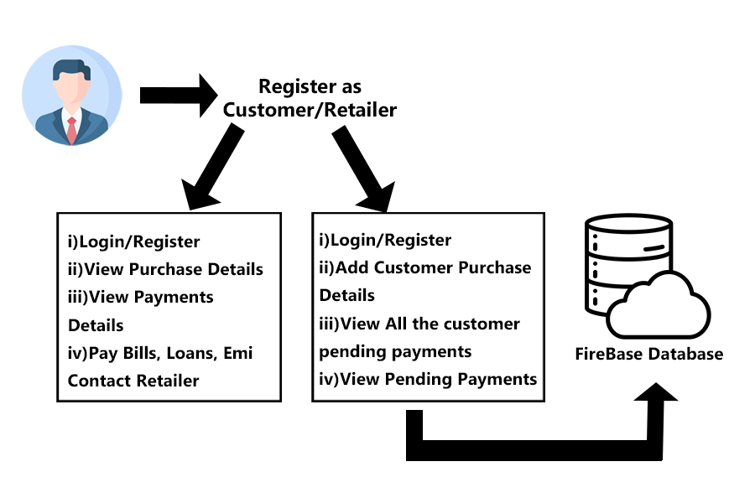
Theoretical Analysis
Flow chart

Slide 8
Hardware/Software Design
Front End - Java
Back End – Firebase Database
IDE - Android Studio
Deployment tool - Docker
Management tool - OpenShift

Slide 9
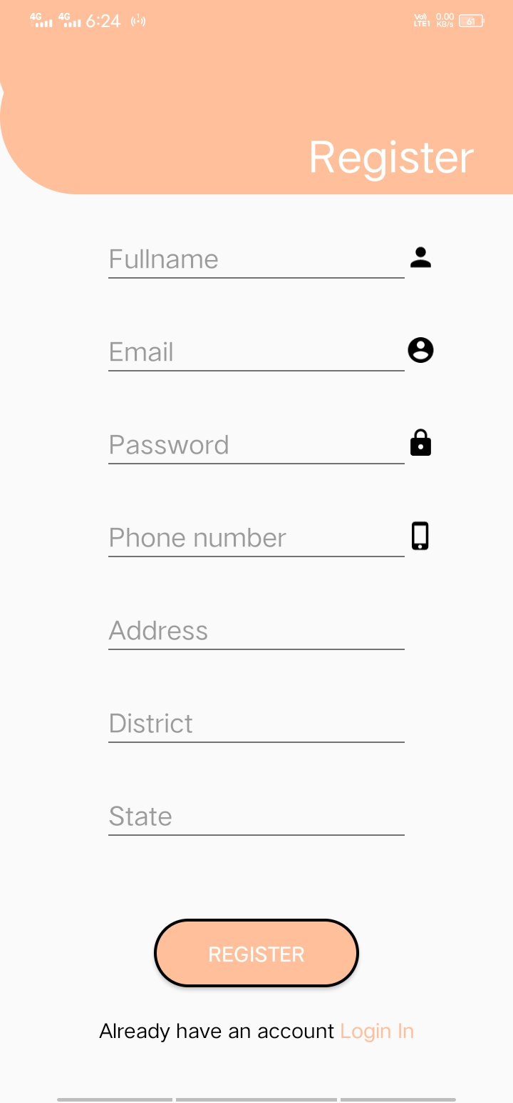
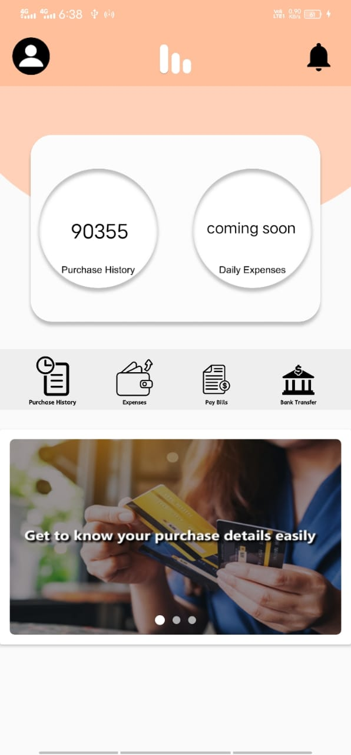
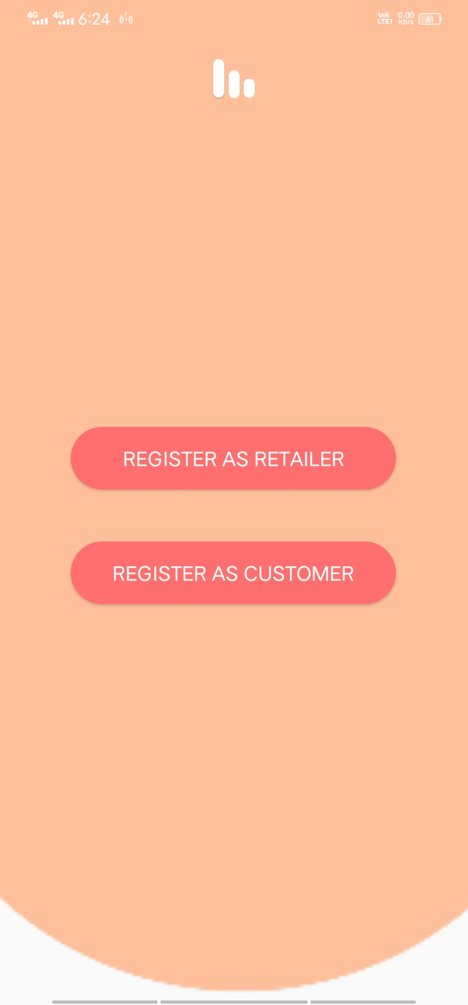
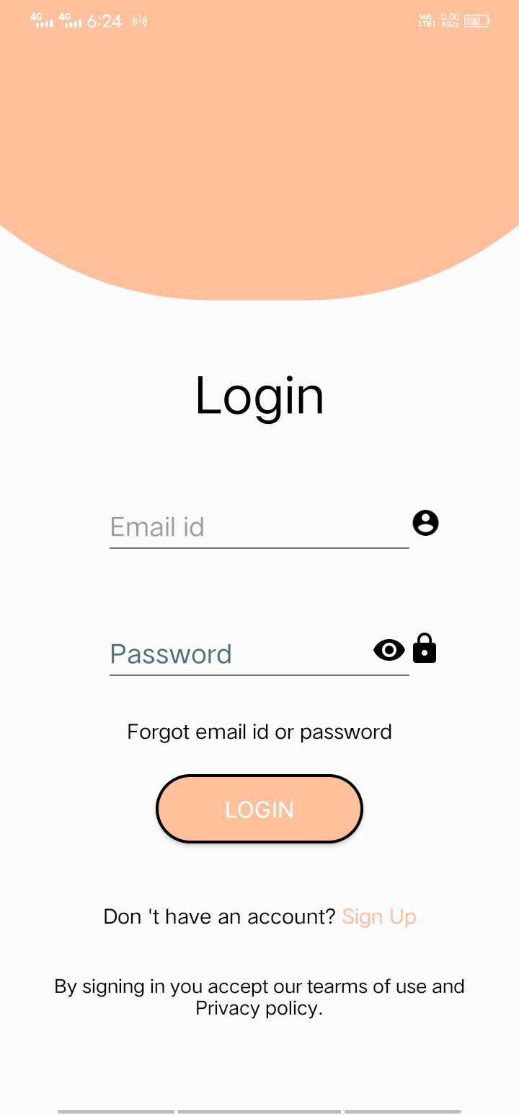
Result

Slide 10
Result

Slide 11
Advantages and Disadvantages
Advantages:
With this application retailer can easily maintain their customers details such as customers purchase details, their pending payments and remind their customer to pay their pending payments.
Customers also can view their purchase details and their bills pay, loans and Emi.
Disadvantages:
Illiterate people cannot access the digital payment

Slide 12
Applications
This application can be use in almost every retailer shop those who want to store their customers details. These customer details can be used to refer later. It is also useful for retailer to manage their customers payment details.

Slide 13
Conclusion
One of the most significant advantages of digital payment is the seamless experience they provide to customers. Reduced dependency on cash, fast transfer speed, and the ease of transacting make online payment a preferred option.

Slide 14
Future Scope
Keep in contact with the retailer and regularly manage the purchase details. With the statistics customer can manage the expenses. It makes the money management easy.

Slide 15
Thank you

